Slide 1
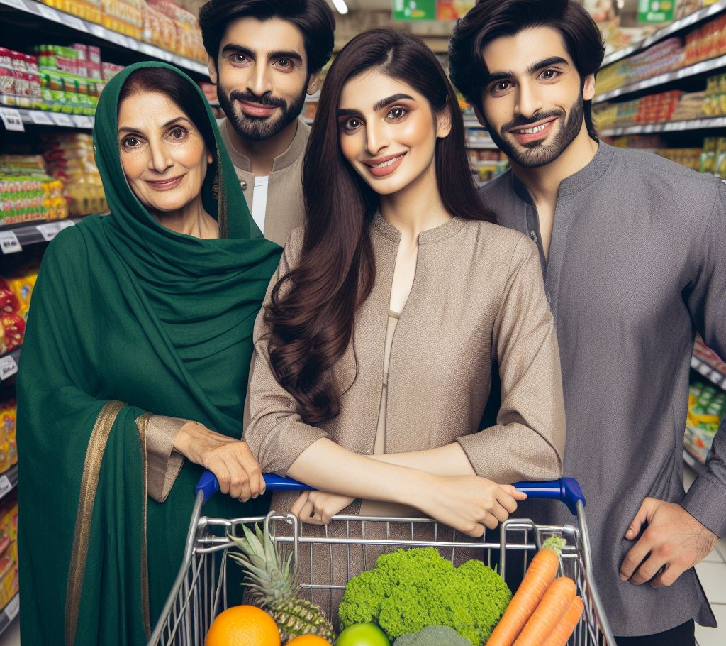
GROCERY STORE Project in Assembly

Slide 2
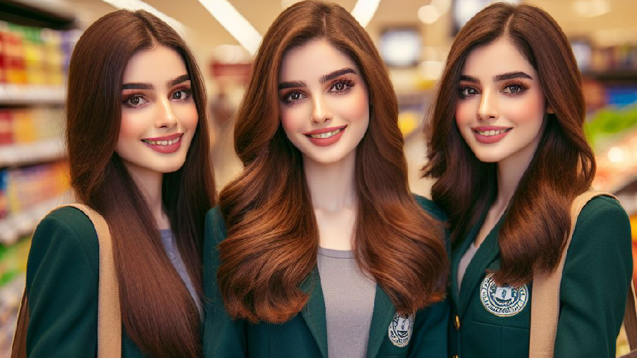
Sania Zaman (uw-22-cs-bs-038) Hina Saif (uw-22-cs-bs-013) Bint-e-Zara ( uw-22-cs-bs-029)

Slide 3
CONTENTS
Introduction
Advantage
Uses
Libraries
what we use
Code
Output
Activity process

Slide 4
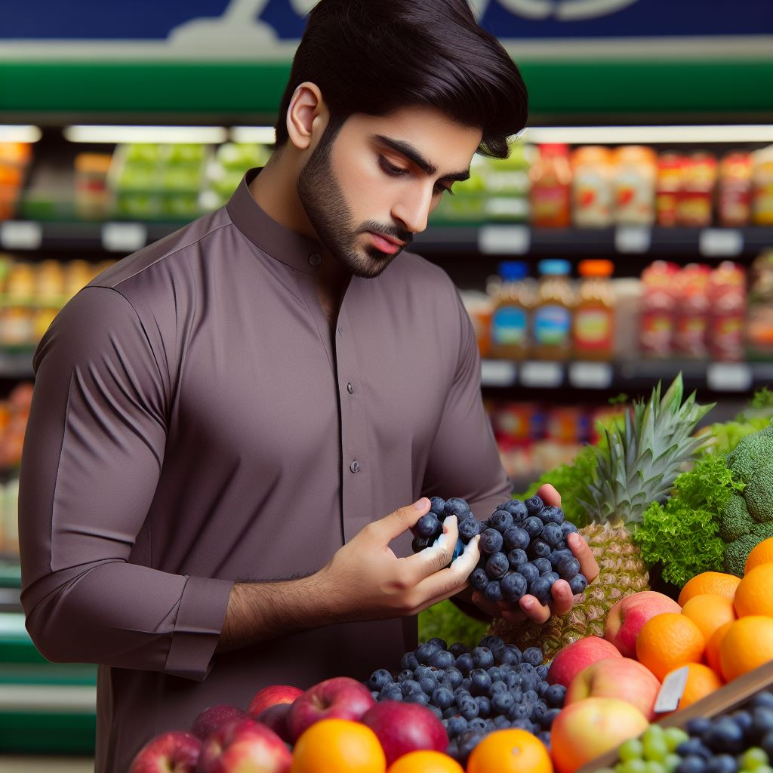
01
Introduction
What is Grocery store?

Slide 5
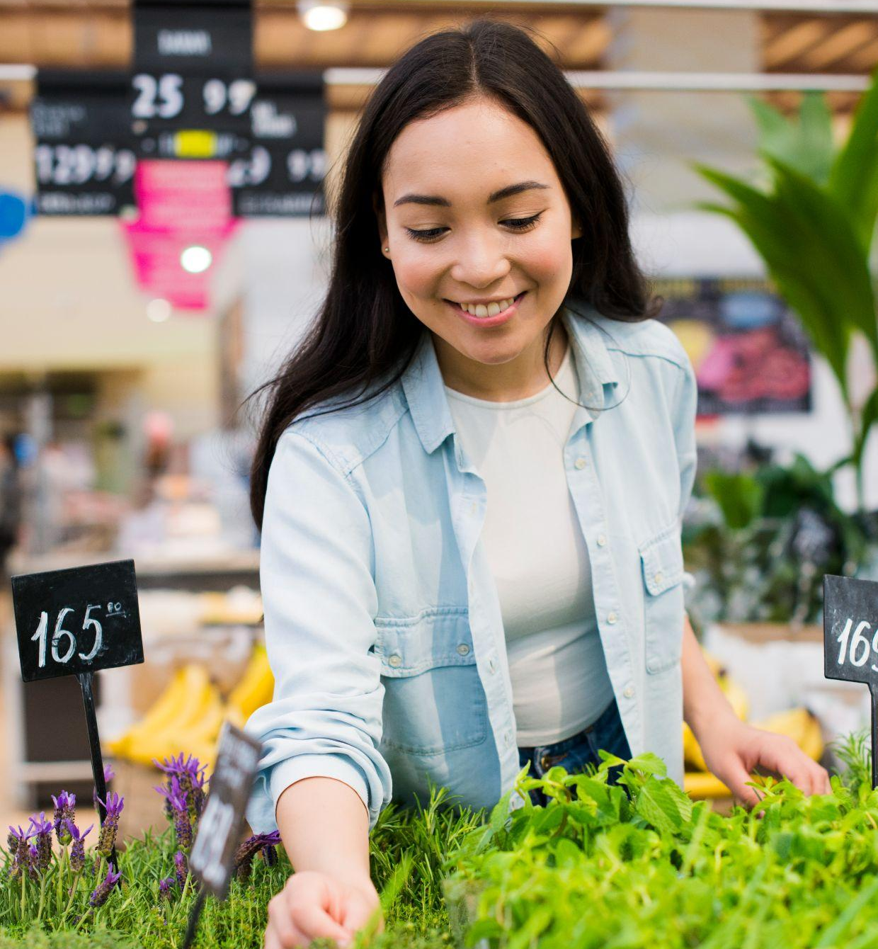
Introduction
A grocery store is a place where you can buy food, household items, and other essentials.

Slide 6
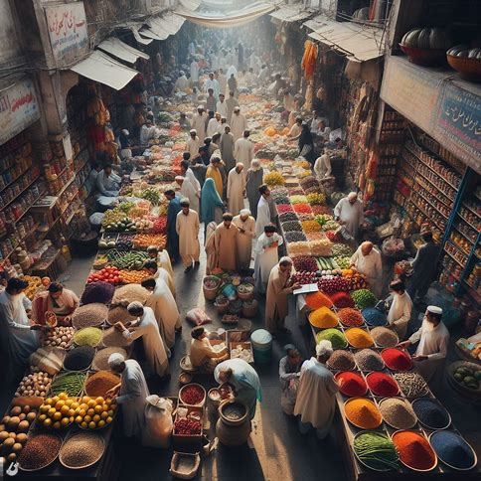
02
Advantages
What is advantage of Grocery store?

Slide 7
Advantages Of Grocery Store
Convenience
Variety
Affordability
Grocery stores often provide competitive prices, promotions, and discounts, making it more affordable to purchase essential items
: Grocery stores provide a one-stop shop for all your food and household needs, making it convenient to find everything in one place
Grocery stores offer a wide range of products, allowing you to choose from a diverse selection of fresh produce, packaged goods, and specialty items.

Slide 8
—SOMEONE FAMOUS
In the aisles of a grocery store, you'll find not just food, but the ingredients for countless memories and delicious adventures!" 🛒✨

Slide 9
OUR ITEMS
Fruits
Vegetables
Meat/Fish
Dairy
Spices
Oil
Apple, bnana, orange, mango , strawberry etc
onion, potato, cucumber, Garlic, tomato etc
Beef, Bacon , Poultry, Fish, Sausage etc
Milk, Butter, Eggs, Cheese, yogurt etc
Salt, pepper, Taco seasoning etc
Bbq sauce, oil, vinegar, soy sauce, spaghetti sauce etc

Slide 10
OUR ITEMS
Baking
Beverage
Snacks
Cosmetic
Household
Sugar, Flour, Vanilla, Chocolates etc
Water, juice, soda, coffee, tea etc
cookies, chips, candy, nuts, popcorn etc
Eye liner, face mask , lipstick, makeup kit etc
Bleach, cleaner , batteries, lightbulb, Dish soap etc

Slide 11
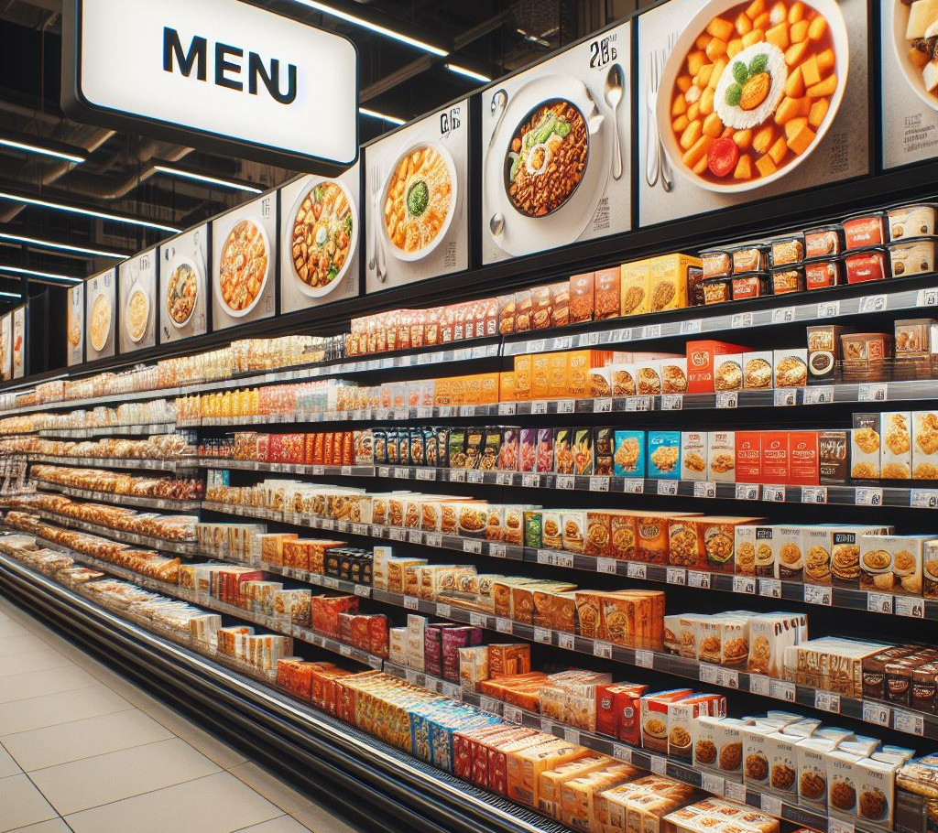
What we use?
Do you know what helps you make your point clear?
jump instructions
Move, add, mul
comapare
Strings

Slide 12
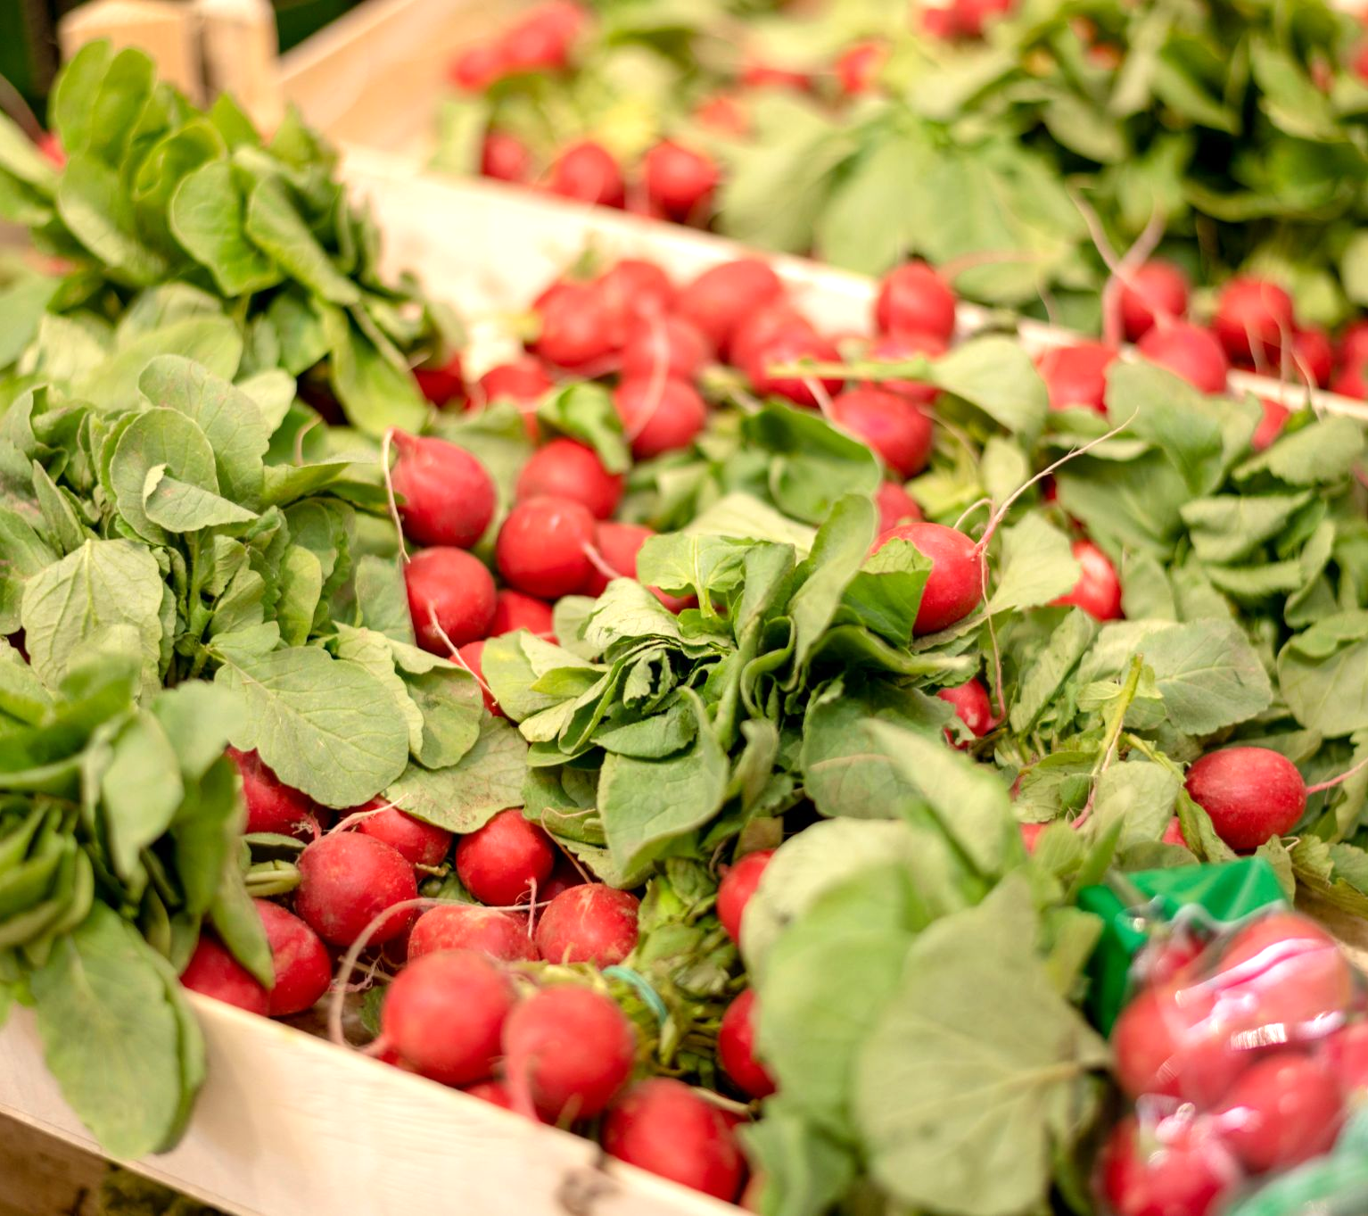
Which operations we perform?
in our code we can:
Choose operation from menu
select item
add item
add quantity

Slide 13
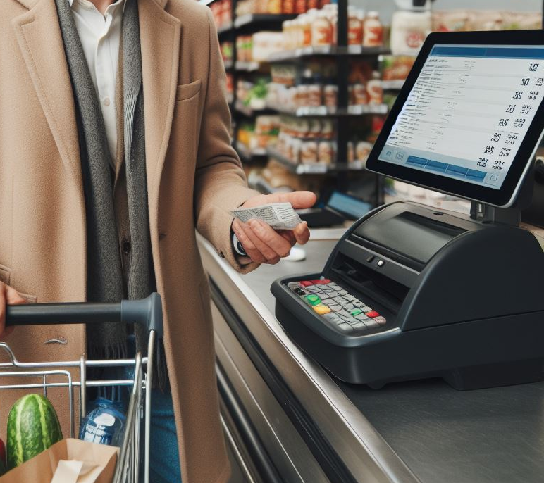
Result
Do you know what results we get?
Generated Bill for the customers

Slide 14
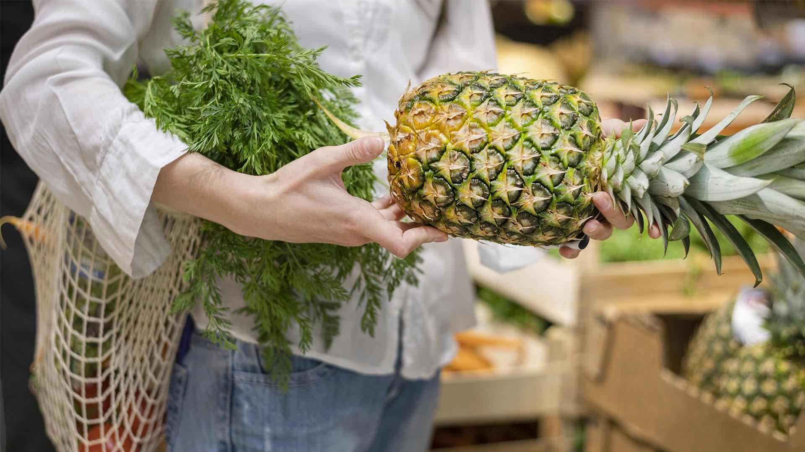
Serves as a form of relaxation, entertainment, and escape

Slide 15
Code Headers

Slide 16
Proto
ExitProcess proto
WriteString proto
WriteInt64 proto
ReadInt64 proto
Str_copy proto
Str_compare proto
Str_length proto
Crlf proto

Slide 17
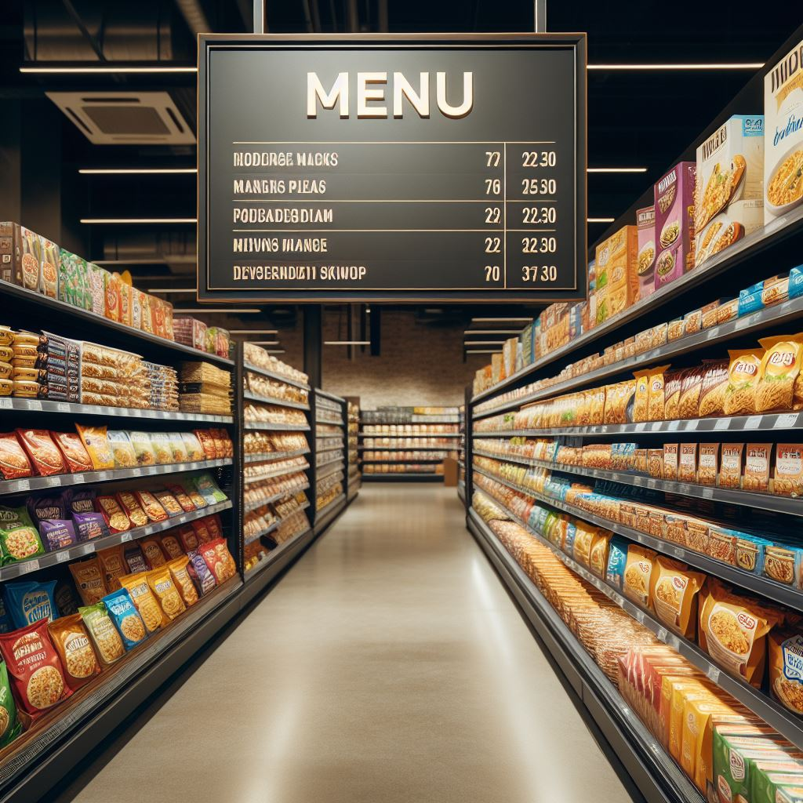
Menu
"Choose an operation:"
1. Fruits 2. Vegetables 3. Meat/Fish
4. Dairy 5. Spices 6. Sauces/Oils
7. Baking 8. Beverages 9. Snacks
10. Cosmetics 11. Households
Enter your choice:
Enter the quantity:

Slide 18
OutPut
Running code on Microsoft visual studio

Slide 19
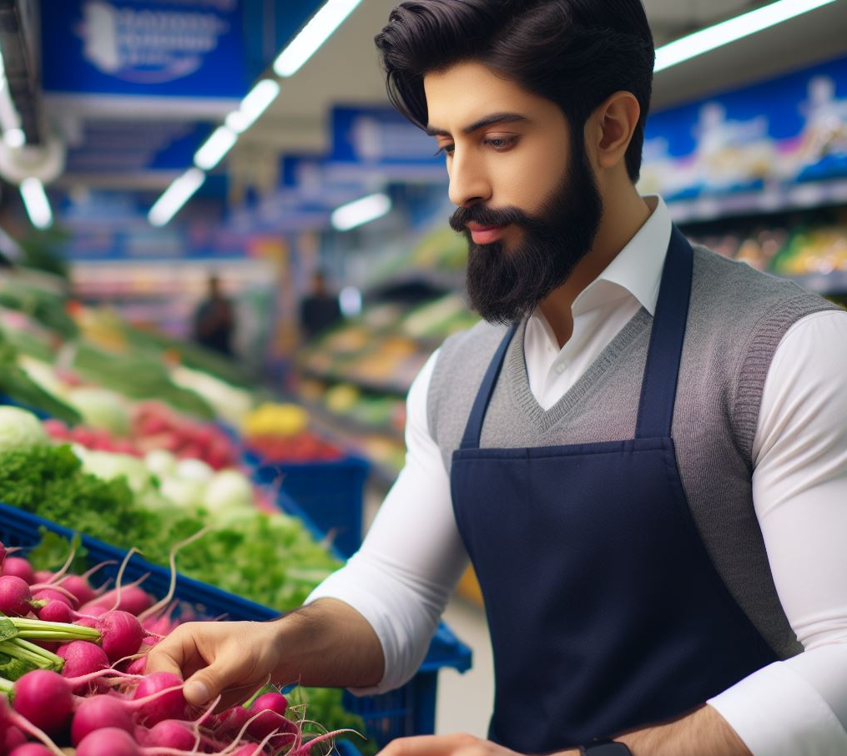
THANKS!
Do you have any questions?
.

